Slide 1
Working Together Principles
Session Template - LEAP

Slide 2
How to use
The following slides can be used to help you facilitate a session with your LEAP to formulate ‘Working Together Principles’
Under each slide there are notes added with further prompts and examples from Breaking Barriers LEAP Members.
We would like to thank the Breaking Barriers LEAP Members for their insight and feedback as well as their role in co-producing a template example which will be shared alongside this PowerPoint.
Acknowledgements

Slide 3
Working Together Principles

Slide 4
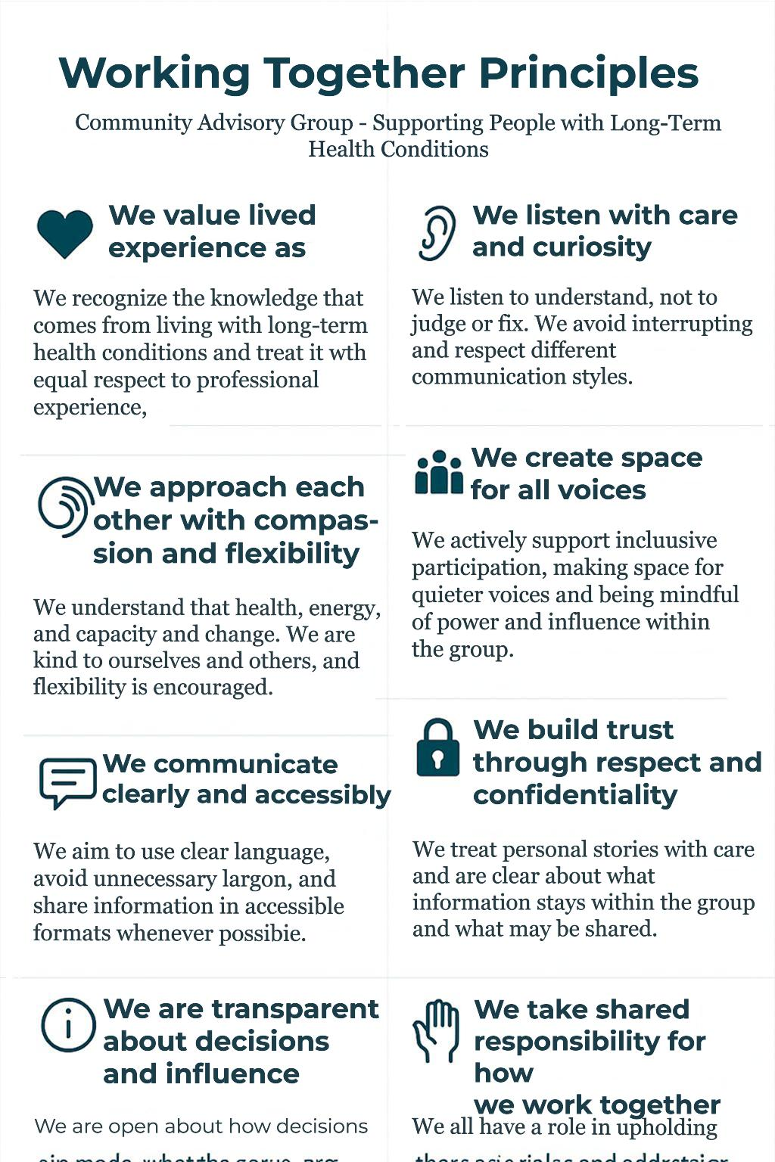
Working Together Principles
What LEAP is about and how we work together
Template for other teams to reference when creating a LEAP and for our reference moving forward.
Example 1
Notes:
We would like to develop some foundation principles like the ones seen in the example.
These principles are all about making sure that LEAP members feel able to contribute and be heard, creating a welcoming, inclusive culture.
The principles will be a guide for how a LEAP works, talks, listens, disagrees, and make decisions together — they can be reviewed and changed if they stop working.

Slide 5
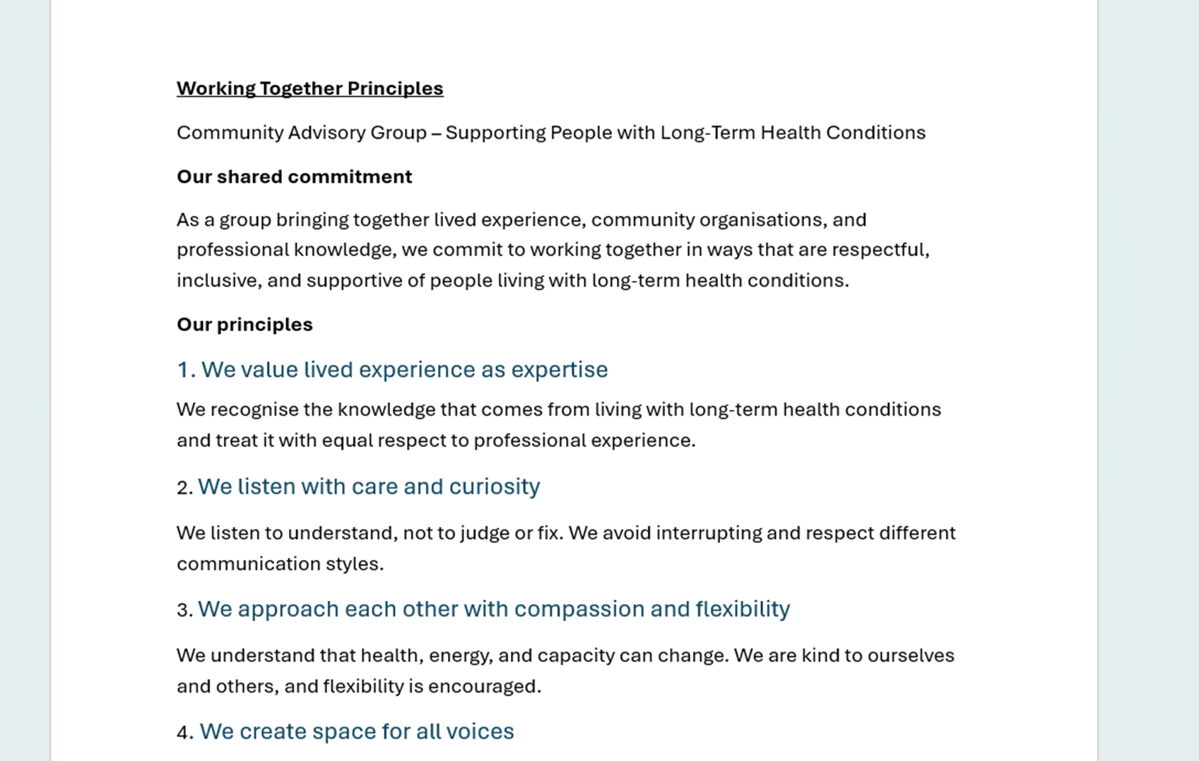
Working Together Principles
Example 2

Slide 6
Working Together Principles
Overview of Topics:
Respect & Inclusion
Listening & Communication
Confidentiality & Trust
Safe Space
Participation & Shared Responsibility
Lived Experience & Decision Making
Practicalities & Accessibility
Notes:
Included some of your comments from the previous workshop and points raised in the evaluation sessions.

Slide 7

Working Together Principles
Respect & Inclusion
• “What does respect look like in practice in this group?”
• “How do we make sure all voices are heard?”
Notes:
Respect & Inclusion
Talking points
•Everyone’s experience and perspective matters
•Different opinions are expected
•Language and behaviour should be respectful
Examples from previous LEAP
• Opportunity to ask questions and respond to feedback.
• Members are able to contribute in a way which is comfortable for them.
• Everyone’s contributions are acknowledged and feels valued
• Members can ask for accommodations, and these can be enacted to support their involvement

Slide 8
Working Together Principles
Listening & Communication
• “What helps you feel properly listened to?”
• “How should we go about managing disagreements or strong views if they arose?”
Notes:
Listening & Communication
Talking points
•Listening to understand, not just to respond
•Avoiding interruptions
•Being clear, honest, and kind
Examples from previous LEAP
• Making sure that meetings are inclusive and everyone has a voice.

Slide 9
Working Together Principles
Confidentiality & Trust
“What needs to stay confidential for people to feel safe?”
“When might information need to be shared more widely?”
Notes:
Confidentiality & Trust
Talking points
•Being clear about what stays in the room
•Respecting personal stories
•Safeguarding and exceptions (e.g. serious concerns)

Slide 10

Working Together Principles
Create a safe space (Inclusive culture)
“Understand the needs of each group member”
How do we support each other to take part in ways that work for us?
Notes:
Examples from previous LEAP:
• Members being able to have their camera on/off; using the Teams chat; taking time out…

Slide 11
Working Together Principles
Participation & Shared Responsibility
“What does fair participation look like for us?”
“How do we support each other to take part in ways that work for us?”
Notes:
Participation & Shared Responsibility
Talking points
•Everyone contributes in different ways
•No pressure to speak all the time—but space to speak when you want to
•Shared responsibility for the group feeling safe and productive
Examples from previous LEAP
• Clarify roles, objectives, timelines, and expectations.
• Establish a main point of contact.

Slide 12
Working Together Principles
Lived Experience & Decision Making
“How do we make sure peoples lived experience is genuinely valued?”
“What do we need in terms of clarity about how decisions are made?”
Notes:
Lived Experience & Decision Making
Talking points
•Valuing lived experience as expertise
•Being clear about what decisions the group can influence
•Transparency about constraints

Slide 13
Working Together Principles
Practicalities & Accessibility
“What practical things help you engage fully in meetings?”
“What gets in the way?”
Notes:
Practicalities & Accessibility
Talking points
•Timekeeping and pacing
•Accessibility needs (breaks, formats, language)
•Clear agendas and follow up
From workshop and evaluation
Keeping workloads manageable. Share documents ahead of meetings.
Finding times to schedule meetings that worked for everyone was often a challenge for the LEAP.

Slide 14
Thank you

