Slide 1
Working Together Principles
Session Template - COAP

Slide 2
How to use
The following slides can be used to help you facilitate a session with your COAP to formulate ‘Working Together Principles’
Under each slide there are notes added with further prompts and examples from Breaking Barriers COAP Members.
We would like to thank the Breaking Barriers COAP Members for their insight and feedback as well as their role in co-producing a template example which will be shared alongside this PowerPoint.
Acknowledgements

Slide 3
Working Together Principles
Notes:
Explain what these are

Slide 4
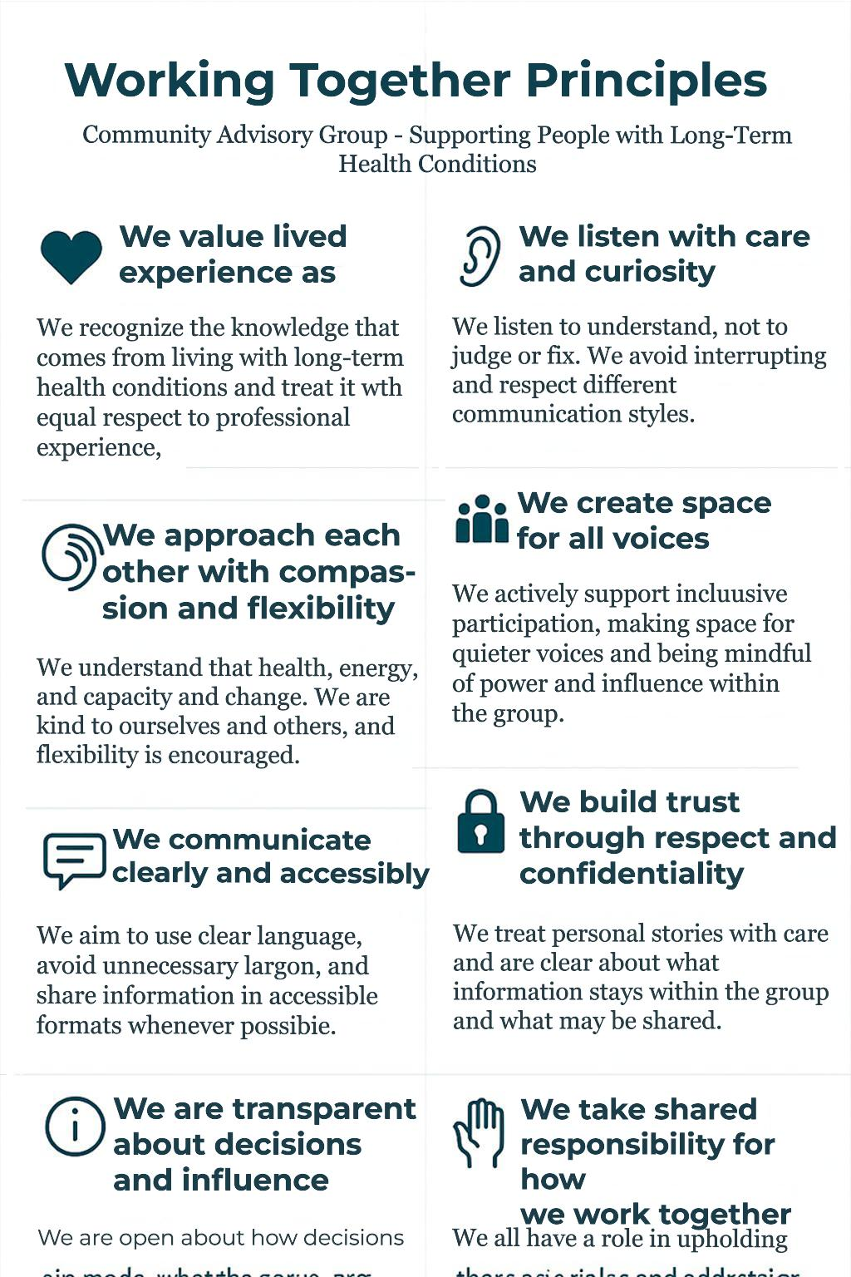
Working Together Principles
What COAP is about and how we work together
For reference moving forward
We can review and update as the partnership progresses
Example 1
Notes:
These aren’t rules being imposed—they’re things that will help members feel able to contribute and be heard, creating a welcoming, inclusive culture.
The principles will be a guide for how a COAP works, talks, listens, disagrees, and make decisions together — they can be reviewed and changed if they stop working.
If you want, these principles can belong to this group. We’ll share them, use them in future meetings, and revisit them to make sure they still support us.
Let’s start with our experiences. Think about a group or meeting you’ve been part of that worked well — What helped that group work well?
And one that didn’t work so well? Why?
What would make this group a good place to be part of?

Slide 5
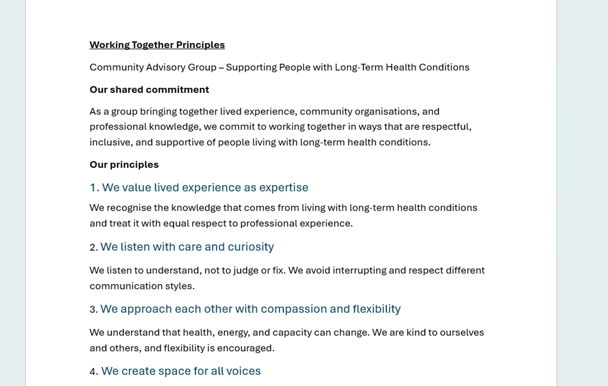
Working Together Principles
Example 2

Slide 6
Working Together Principles
Overview of Topics:
Respect & Inclusion
Listening & Communication
Shared Learning
Participation & Shared Responsibility
Lived Experience & Decision Making
Confidentiality & Trust
Practicalities & Accessibility

Slide 7

Working Together Principles
Respect & Inclusion
• “What does respect look like in practice in this group?”
• “How do we make sure all voices are heard?”
Notes:
Respect & Inclusion
Prompt questions
•“What does respect look like in practice in this group?”
•“How do we make sure all voices are heard”
Talking points
•Everyone’s experience and perspective matters
•Different opinions are expected
•Language and behaviour should be respectful
Example from previous COAP- Valuing people’s time and contributions, Opportunity to ask questions and respond to feedback.

Slide 8
Working Together Principles
Listening & Communication
• “What helps you feel properly listened to?”
• “How should we go about managing disagreements or strong views if they arose?”
Notes:
Listening & Communication
Prompt questions
•“What helps you feel properly listened to?”
•“How should we go about managing disagreements or strong views if they arose?”
Talking points
•Listening to understand, not just to respond
•Avoiding interruptions
•Being clear, honest, and kind
Example from previous COAP- Avoiding the use of technical jargon or acronyms in order to make sure that everyone feels included in conversations.

Slide 9

Working Together Principles
Shared Learning
Recognise previous experiences and expertise that each member brings to the team.
Learn from other organisations which can shape the ways you support people.
Sharing Insight
Notes:
Listening & Communication
Prompt questions
Does this resonate with you?
Any other points you would like to add?
Talking points
Example from previous COAP- Recognise previous experiences and expertise that each member brings to the team.
Learn from other organisations which can shape the ways you support people.
Fostering a culture of learning/keeping an open mind to new ideas and collaboration.

Slide 10
Working Together Principles
Participation & Shared Responsibility
“What does fair participation look like for us?”
“How do we support each other to take part in ways that work for us?”
Notes:
Participation & Shared Responsibility
Prompt questions
•“What does fair participation look like for us?”
•“How do we support each other to take part in ways that work for us?”
Incentive for attendance & remuneration.
Representation at meetings.
Talking points
•Everyone contributes in different ways
•No pressure to speak all the time—but space to speak when you want to
•Shared responsibility for the group feeling safe and productive
Example from previous COAP- Clarify roles, objectives, timelines, and expectations. Transparency and main point of contact.
Reaching a mutual agreement for the number of meetings and providing flexibility to fit these meetings around other work.

Slide 11
Working Together Principles
Lived Experience & Decision Making
“How do we make sure peoples lived experience is genuinely valued?”
“What do we need in terms of clarity about how decisions are made?”
Notes:
Lived Experience & Decision Making
Especially important for community advisory groups.
Prompt questions
•“How do we make sure people’s lived experience is genuinely valued?”
•“What do we need in terms of clarity about how decisions are made?”
Talking points
•Valuing lived experience as expertise
•Being clear about what decisions the group can influence
•Transparency about constraints

Slide 12
Working Together Principles
Confidentiality & Trust
“What needs to stay confidential for people to feel safe?”
“When might information need to be shared more widely?”
Notes:
Confidentiality & Trust
Talking points
•Being clear about what stays in the room
•Respecting personal stories
•Safeguarding and exceptions (e.g. serious concerns)

Slide 13
Working Together Principles
Practicalities & Accessibility
“What practical things help you engage fully in meetings?”
“What gets in the way?”
Notes:
Practicalities & Accessibility
Talking points
•Timekeeping and pacing
•Accessibility needs (breaks, formats, language)
•Clear agendas and follow up
Example from previous COAP- Clear plan of what the meeting is for. Keeping workloads manageable. Share Documents ahead of meetings.

Slide 14
Working Together Principles
Our Principles:
We will…
Notes:
4. Turning Ideas into Principles (10–15 minutes)
Now bring it together.
How to do it
•Reflect back what you’ve heard
•Group comments into 6–8 short, clear principles
•Keep language plain and collective, e.g. “We will…”
Example structure
•We will listen respectfully and without interruption.
•We will value lived experience as expertise.
•We will be honest about what the group can and cannot influence.
Prompt
•“Does this reflect what we’ve said? Is anything missing?”
________________________________________
5. Agree, Review & Revisit (5 minutes)
Talking points
•These principles belong to the group
•They’re a living document
•They can be reviewed at any time before or after meetings if needed.
Prompt questions
•“Are these principles something we can all commit to?”
•“What format, example 1 or example 2?”
•“How will we gently challenge things if we drift away from them?”
________________________________________
Thank you for shaping this together—this sets the tone for how we work going forward.

